Slide 1
MODERN SLAVERY QUIZ
(Not so trivial)
Source: Globalslaveryindex.org
International Labour Organisation Catholic Education Sandhurst Diocese

Slide 2
Modern Slavery Quiz Question 1
The answer is…
True
True or False
The definition of Modern Slavery is “a situation of exploitation that a person cannot refuse or leave because of threats, violence, coercion, deception, and/or abuse of power.”

Slide 3
Modern Slavery Quiz Question 2
The answer is…
50 million
According to the Global Slavery Index, how many people around the world are living in modern slavery conditions?
A. 10 million
B. 20 million
C. 30 million
D. 50 million

Slide 4
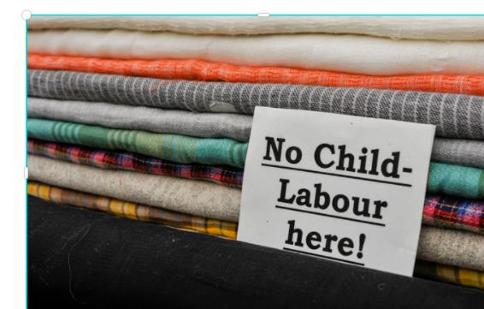
Modern Slavery Quiz Question 3
The answer is…
25%
What percentage of people affected by Modern Slavery are children?
A. 15%
B. 5%
C. 25%
D. 10%

Slide 5
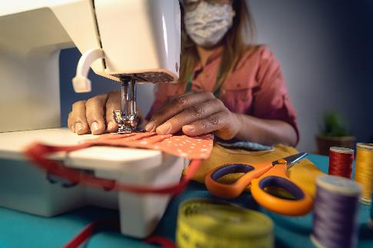
Modern Slavery Quiz Question 4
The answer is…
71%
What percentage of people affected by Modern Slavery are women?
A. 29%
B. 5%
C. 55%
D. 71%

Slide 6
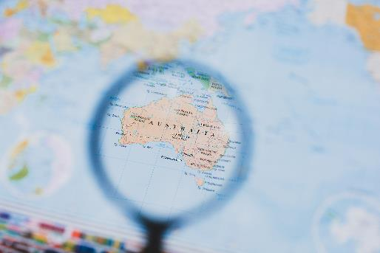
Modern Slavery Quiz Question 5
The answer is…
1,900
How many people in Australia are victims of modern slavery ?
A. 1,000
B. 500
C. 20,000
D. 100
D. 1,900

Slide 7
Modern Slavery Quiz Question 6
The answer is…
22 million
What percentage of people are affected by Modern Slavery in forced marriages:
A. 15.4 million
B. 2 million
C. 5.5 million
D. 22 million

Slide 8
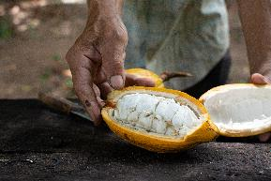
Modern Slavery Quiz Question 7
The answer is…
All of the above
Which of the industries may be involved in modern slavery?
A. Construction
B. Agriculture
C. Clothes making
D. Hospitality
E. Domestic Work
F. All of the above

Slide 9
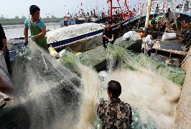
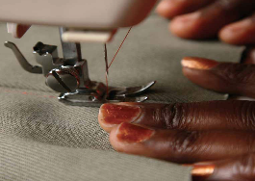
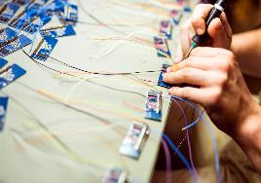
Modern Slavery Quiz Question 8
The answer is…
All of the above
Which of the following imported products may be produced from forced labour or modern slavery?
A. Clothes
B. Laptops & mobile phones
C. Fish
D. Rice
E. Cocoa
F. All of the above
G. None

Slide 10
Modern Slavery Quiz Question 9
The answer is…
Laptop, computers and mobile phones
Which is the top ranked product at risk of modern slavery in the supply chain worldwide:
A. Cocoa
B. Garments
C. Fish
D. Laptop, computers and mobile phones

